Slide 1

Game Management
and Level Design
Software Requirement Specification
By, MR_777 Association

Slide 2

Presenters
Muhammad Ammar
Shaban Zaman
Harris Bin Abid
Noman Shoaib
BSCS_F19_M_63
BSCS_F19_M_65
BSCS_F19_M_84
BSCS_F19_M_86

Slide 3

Introduction
about the Game Project
Cyberpunk 2077 is an open-world, action-adventure story set in Night City by CD Projekt RED. You play as V, a mercenary outlaw going after a one-of-a-kind implant that is the key to immortality. You can customize your character’s cyberware, skillset and playstyle, and explore a vast city where the choices you make shape the story and the world around you.

Slide 4


LIVE IN THE CITY OF FUTURE
Cyberpunk 2077 is set in an Alternate History of Dark Future, where corporations rule, and focuses on Age of Computers, Human Augmentations, and famous Japanese Corporation Arisaka, which was found during the age of World War II. Cyberpunk 2077 is the most anticipated video game of entire history.
Game Setting

Slide 5

REQUIREMENTS
Functional Requirements
Demanding Features
Non-Functional Requirements
Optimization / Technical Features
Requirements

Slide 6

GAMEPLAY FEATURES
Age of Computers and MiliTech
Role Playing Game Genre
Low-Life, High-Tech
Alternate History, with Future Setting
Age of Augmentations
Dynamic Story and Background
Demanding Features

Slide 7
GAMEPLAY FEATURES
Vertical City Layout
Four cultures with specific regions
Wide variety of Vehicles and Combat focused
Highly Anticipated of all the Time in History
Has Chinese and Japanese Style of Art, Theme and Vibe
Demanding Features

Slide 8
TECHNICAL FEATURES
Single-Player Focused
Highly Optimized for PC, PS5 and XBOX Series X/S
Programming Language used: C++
Engine used: REDengine 4
Low on Processor and RAM
No DRM Protection
Optimization Features

Slide 9
TECHNICAL FEATURES
Almost 20 years of Development work
Employers currently working 6 days a week
Takes only 70GB of Storage
Cyberpunk 2077 is Ray-Traced
Supports RTX 30 Series of GPUs
Used real world ARCH Vehicles by Keanu Reeves
Optimization Features

Slide 10
BUDGET
175 Million to 220 Million USD
1,500 people are involved in the Project Globally
Record breaking Expectations and Pre-Orders
Our Competitor GTA 5 had the Budget of 265 Million USD
Development Work

Slide 11
PROJECT DETAILS
Cooperation Partners
Canadian Studio Digital Scapes - Crafting Tools
QLOC - Quality Assurance
NVIDIA - Realtime Ray Tracing
Wroclaw Office - Research and Development
Development Work

Slide 12
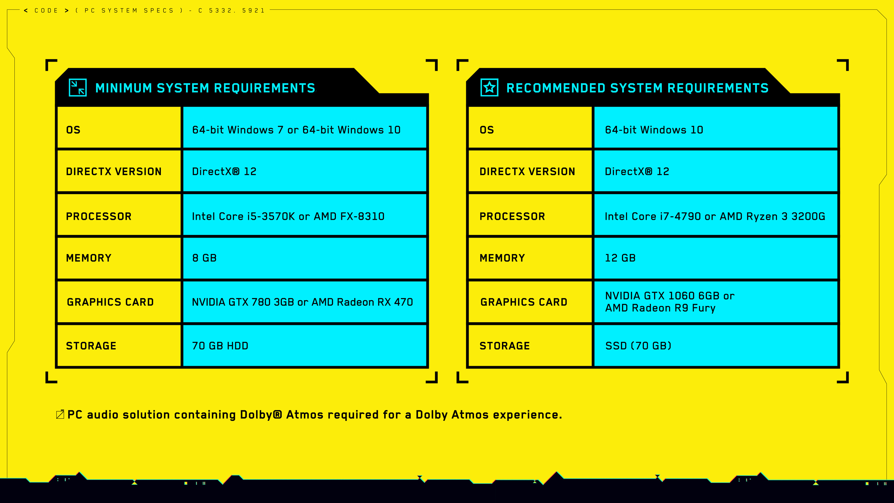

Slide 13
CARRIERs
Carriers for Game Programmers
Perfect C++ and Optimization Skills
Proficiency in Code and Algorithm
Experience in Playing and Developing RPG Games
Minimum 3 years of Developing Experience
CD Projekt RED

Slide 14

Hello to the Future

